Slide 1
Dimensions of Health

Slide 2
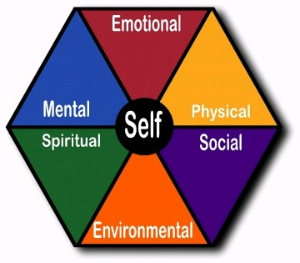

Slide 3
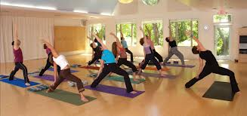
1.Physical Health

Slide 4
Physical health is discussed in terms of wellness of the body and absence of bodily disorders. It includes, for example, characteristics such as your weight, susceptibility to disease, nutritional status, fitness and powers of recovery from illness.

Slide 5

2. Social Health

Slide 6
Social health is your ability to get along with people in your life and have productive role in your family or community. It relates to social abilities skills and insights. Positive social interaction can be seen both as a means of achieving health and as a part of health it self.

Slide 7
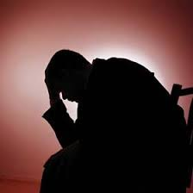
3.Mental Health

Slide 8
It is a state of balance between the individual and surrounding world, a state of harmony between oneself and others, a co – existence between the realities of the self and that of other people, and that of environment.
Mental or emotional health is expressed in terms of understanding your emotions, coping with everyday problems and handling stress in a non – destructive way. The mental components of health are related to your self – esteem, self – confidence and the way you cope with problems.

Slide 9

Spiritual Health

Slide 10
Spiritual health may involve a religious belief, or it may simply relate to the sense of being part of a large environment or world.
It is intangible “something” that is transcends (exceed) physiology and psychology. As a relatively new concept, it seems to defy (refuse) concrete definition. It includes integrity, principal and ethics, the purpose in life, commitment to some higher being and belief in concepts that are not subject to “state of art” explanation.

Slide 11

Emotional Health

Slide 12
Historically the mental and emotional dimensions have been seen as one element or as two closely related elements. However, as more research become available a definite deference is emerging. Mental health can be seen as “knowing” or ”cognition” while emotional health relates to “feeling”. Experts in psychobiology have been relatively successful in isolating these two separate dimensions. With this new data, the mental and emotional aspects of humanness may have to be viewed as two separate dimensions of human health.
Emotions are the feeling which have great role in your life and led to the modification of attitude, conducive (contributing) to personal adjustment and well being.
Emotional health means emotional fitness and emotional control.
Notes:
A person can be called emotionally healthy if his emotions are always positive, and has full control over his emotions. On the other hand, a person who has no control over his emotion or is over powered with negative emotions can be called emotionally imbalance or emotional ill.

Slide 13


Slide 14
The internal environment of men himself and external environment which surround him reflect the health status of the individual, the society and the nation.
Sanitation is one of the important aspect of environmental health. It is the quality of living that is expressed in clean home, clean neighborhood and clean community.
Environment sanitation can be defined as “the control of all those factors in the man’s physical environment which exercise or may exercise a negative effect on his physical development, health and survival.

Slide 15
Others
A few other dimensions have also been suggested such as
Philosophical dimension (health)
Cultural dimension (health)
Socio – economic dimension (health)
Educational dimension (health)
Nutritional dimension (health)
Curative dimension (health)
Preventive dimension (health)

Slide 16
Thank You

