Slide 1
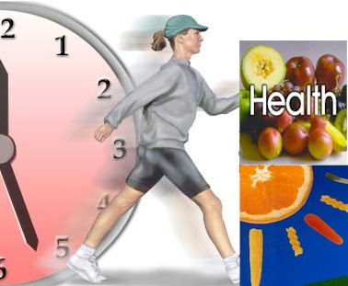

Slide 2
Concept of Health
Health is important for everyone because when you are healthy you can enjoy life.
A nation’s success depends on its people health.
Health is a fundamental human right.

Slide 3
Meaning of Health
Dictionary meaning of health is “freedom from disease, sound body and mind etc; that condition in which functions of body and mind are duly discharged”.
Optimum health may be continuum along linear scale, form near death at one end to the optimum health of the other.
Optimum health would be that level which would enable the individual to live life to the fullest.
Health is the way; there is no way to health. Let all the habits of living be health promoting.
Health is not static.

Slide 4
Definition of Health
Health is a state of complete physical, mental and social well being and not merely an absence of diseases or infirmity.
Recently this definition has been amplified and it has been added, “attainment of a level of health will enable every individual to lead a socially and economically productive life.”
by World Health Organization.

Slide 5
Health is the condition of being sound in body, mind or spirit, especially freedom from physical disease or pain.
by Webster.

