Slide 1
Introduction to Kinesiology and Sports Biomechanics

Slide 2
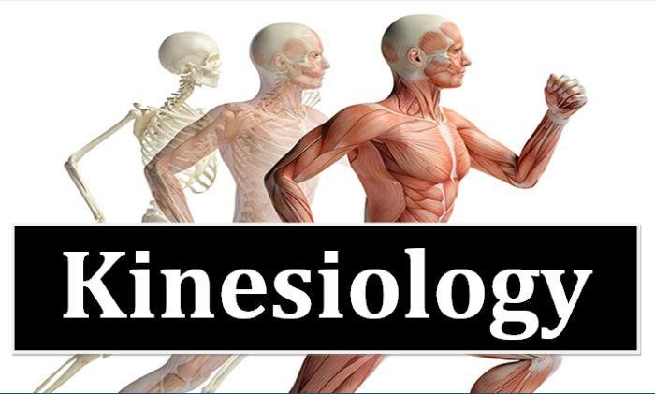
Kinesiology-Meaning
Kinesiology = Kinein(motion) + Logus(Study)
Thus, Kinesiology= Study of Motion.
This field of knowledge concerned with studying the joint, bone , muscle, etc. and their degree and sequence of involvement in the motion along with the mechanical principle applied on them.

Slide 3
Kinesiology-Definition
Thus, kinesiology can be defined as,
“Kinesiology is a whole scholarly field of motion analysis that analyzes the movement on the basis of anatomical(osteology,arthrology,myological,etc.), physiological and associated mechanical principle relevant to it.
It seeks to answer following questions about a movement:
Which bones, muscle and joints are involved?
What is the degree of their involvement?
What is the sequence of their involvement?
What mechanical principles are applied in their involvement?

Slide 4
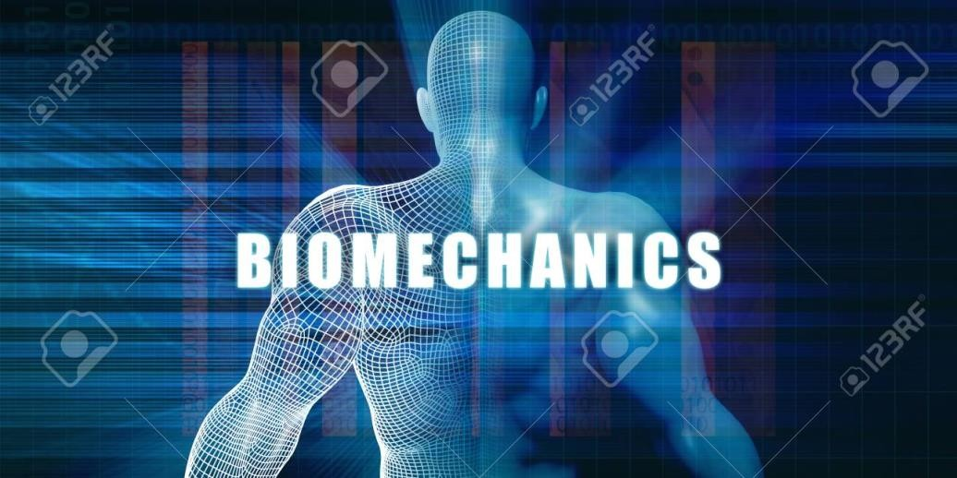
Biomechanics- Meaning
Technical and scientific development in the domain of kinesiology prompted the need for the refinement of subject in 1960.
This lead to the development of “Biomechanics”.
Biomechanics= Bio(life) + Mechanics(branch of physics).
‘Studying the locomotion of living systems with the help of principles and concepts of
Mechanics.’

Slide 5
Biomechanics-Definition
Biomechanics can be defined as,
‘ Biomechanics is a field of knowledge that is concerned with studying the motion of a living organism via analyzing, assessing and describing it via the application of mechanical principles.’
Or
‘Biomechanics is the study of forces(both internal and external forces) and their effects on the living systems and its locomotion’

Slide 6
Importance of Biomechanics in Physical Education
Knowledge of biomechanics helps to realize and understand the underlying principle of the efficient structure of the competitive sports performance.
Knowledge of biomechanics helps in the improvement of motor qualities.
Knowledge of biomechanics helps an athlete to conduct self
evaluation.
Knowledge of biomechanics helps in formulation and understanding new rules and regulation of the sports, games and facilities, etc.
Knowledge of biomechanics helps in development and acceptance of new technique and skills.
Knowledge of biomechanics helps in the selection of athlete/players for specific sports an games.
iii.

Slide 7
Importance of Biomechanics in Physical Education
Knowledge of biomechanics helps in the selection of equipment and facilities.
Knowledge of biomechanics helps in the prevention, protection and rehabilitation from the sports injuries.
It helps to identify the mechanical advantage and disadvantage of the human locomotion.
It helps in diagnostic teaching.
It helps in diagnostic coaching.
It helps in correcting postural deformities.

Slide 8
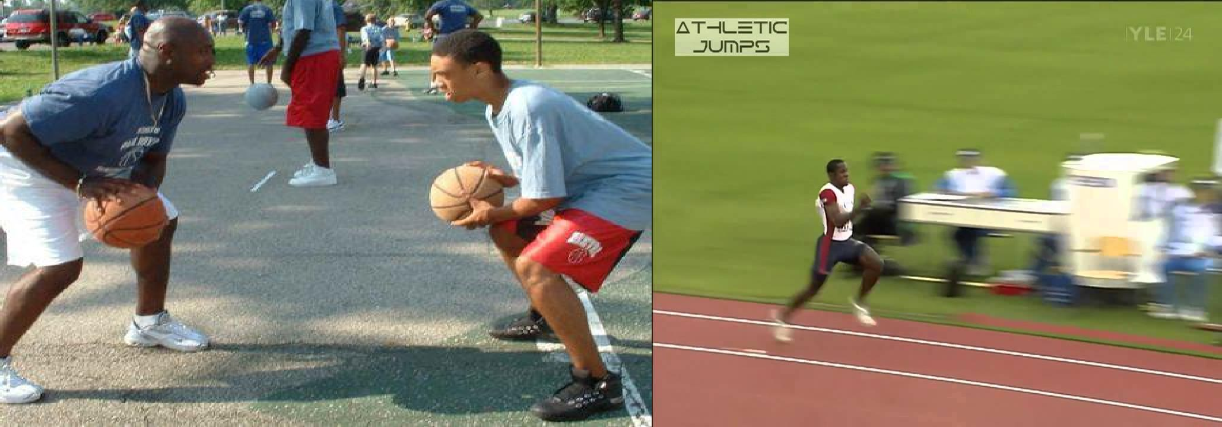
Importance of Biomechanics in Physical Education
Knowledge of biomechanics helps to realize and understand the underlying principle of the efficient structure of the competitive sports performance.

Slide 9
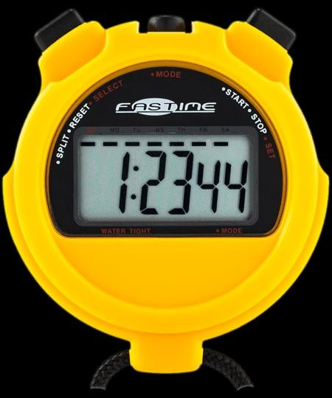
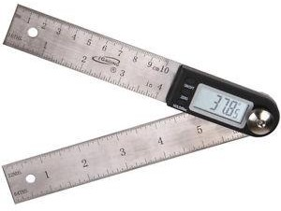
Importance of Biomechanics in Physical Education
Knowledge of biomechanics helps in the improvement of motor qualities.
Biomechanics help in designing systematic and scientific training and selecting the appropriate means of development of the motor qualities.

Slide 10
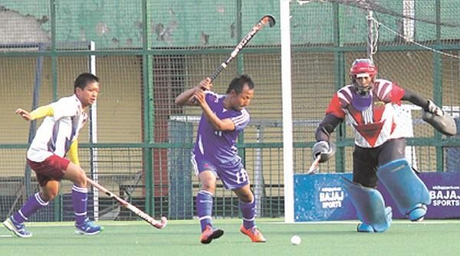
Importance of Biomechanics in Physical Education
Knowledge of biomechanics helps an athlete to conduct self evaluation.

Slide 11
Importance of Biomechanics in Physical Education
Knowledge of biomechanics helps in formulation and understanding new rules and regulation of the sports, games and facilities, etc.
Changes in rules and regulation for decreasing sports injuries.
Changes in rules for standardizing performance recording process.
Changes in rules with respect to making sports more challenging.

Slide 12
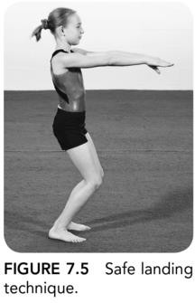
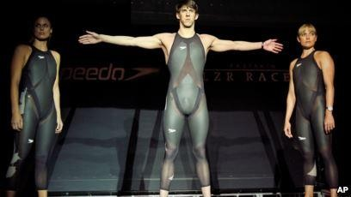

Slide 13
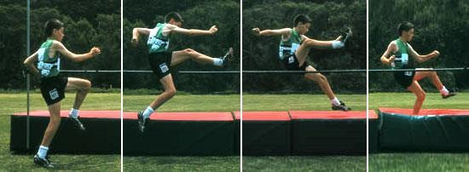
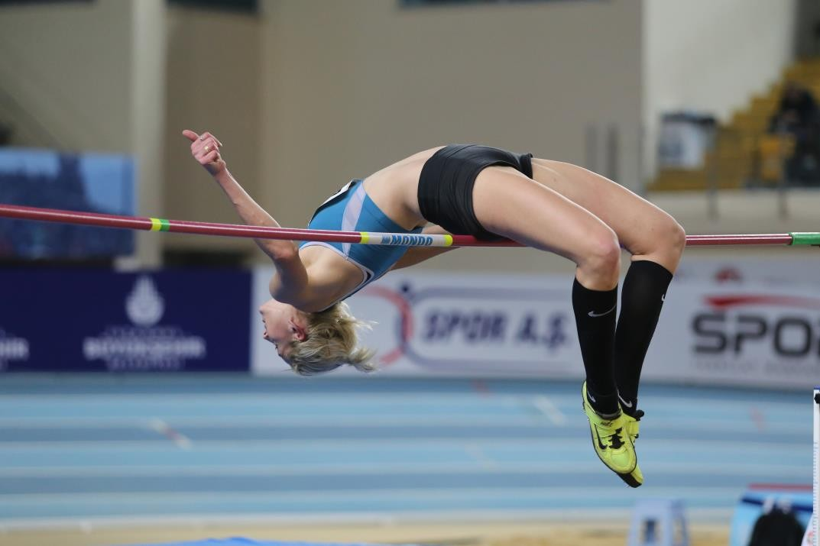
Importance of Biomechanics in Physical Education
Knowledge of biomechanics helps in development and acceptance of new technique and skills.

Slide 14
Importance of Biomechanics in Physical Education
Knowledge of biomechanics helps in the selection of athlete/players for specific sports an games.
Every game has some mechanical demands. Some of it are:
Displace center of gravity of the person.
Produce maximum velocity at the end of movement.
Disruption of stability to efficiently and gracefully execute movement.

Slide 15
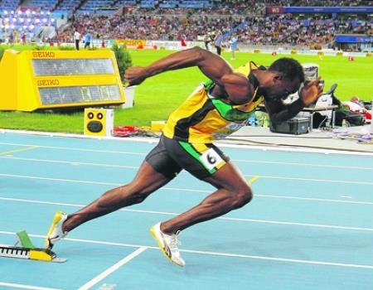
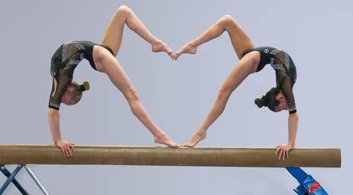

Slide 16
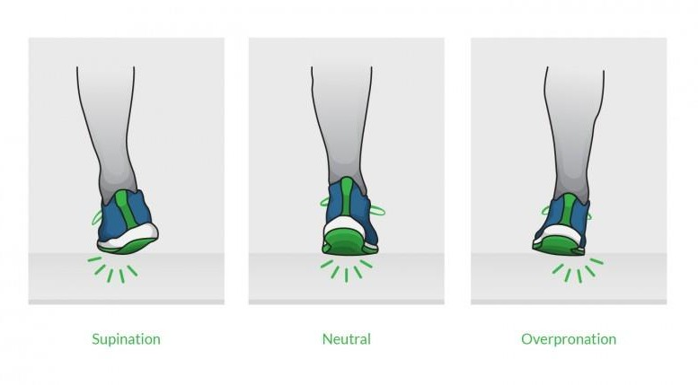
Importance of Biomechanics in Physical Education
Knowledge of biomechanics helps in the selection of equipment and facilities.

Slide 17
Importance of Biomechanics in Physical Education
Knowledge of biomechanics helps in the prevention, protection and rehabilitation from the sports injuries.
Prevention- removal of causes of injuries.(as in gymnastics rule change.)
Protection- minimize the risk of injuries during the activity.(ex. Mouth guard, shin guards, or technique like catching technique in cricket.)
Rehabilitation- extensive biomechanical data on exercises and their effect on the body assists in physiotherapy.

Slide 18
Importance of Biomechanics in Physical Education
It helps to identify the mechanical advantage and disadvantage of the human locomotion.
It helps in diagnostic teaching.
Diagnostics= indepth analysis of all factors contributing to the occurance of a condition.
It helps in diagnostic coaching
Helps in correcting postural deformities
As helps in identifying and developing orthotics to alleviate them.

Slide 19
Importance of Kinesiology in physical Education
To provide the future physical education teacher/coaches with the knowledge necessary for analyzing human motion.
To assist in the learning and improvement of motor skills via the application of analysis of motion.
With the applied anatomic background the knowledge of kinesiology helps to prevent injuries.
Economy of the movement can be ensured.
Effectiveness of the movement can be ensured.
For clinical/rehabilitation purposes kinesiology has great importance.
Designing and teaching of exercise/conditioning
/fundamental movements the knowledge of kinesiology is must.

Slide 20
Importance of Kinesiology in physical Education
Self realization about own performance is best realized by the athlete themselves with the background of kinesiology.
To discover and recognize the underlying principles of movement.
It is an educational experience for physical education and physical medicine.
Effective teaching of motor skills with knowledge of kinesiology are best achieved in regards to
a.Fundamental motor skills
b. Specialized motor skills
Evaluation of exercise and activity from the point of view of their effect on the human structure.

Slide 21
Importance of Kinesiology in physical Education
For physiotherapy, physical medicine purposes.
For postural analysis, and corrective physical education.

Slide 22
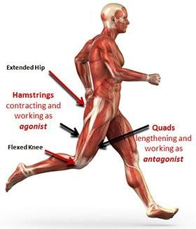
Importance of Kinesiology in physical Education
To provide the future physical education teacher/coaches with the knowledge necessary for analyzing human motion.
Analysis specific to musculoskeletal system involved in the motion.

Slide 23
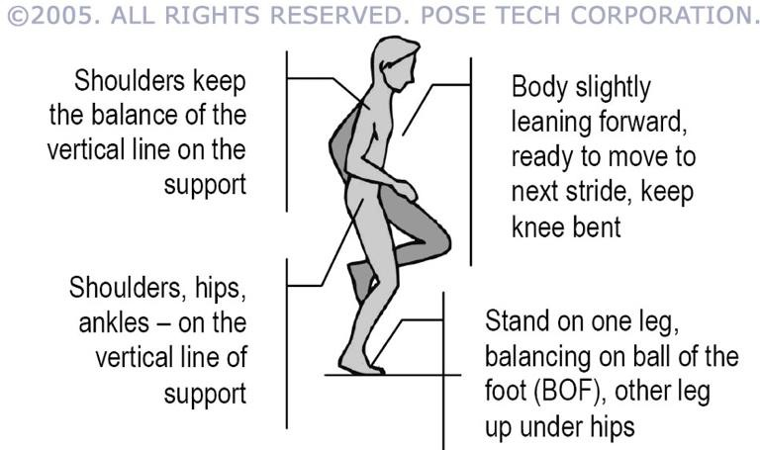
Importance of Kinesiology in physical Education
To assist in the learning and improvement of motor skills via the application of analysis of motion.
Using the findings of analysis to formulate the ideal technique of the motor action which assists in learning it and also in comparison to improve it.

Slide 24
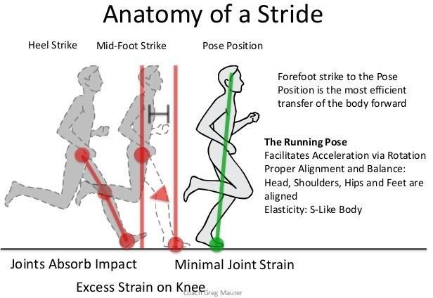
Importance of Kinesiology in physical Education
With the applied anatomic background the knowledge of kinesiology helps to prevent injuries.

Slide 25
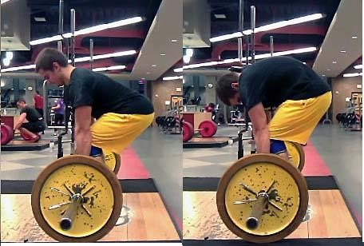

Slide 26
Importance of Kinesiology in physical Education
Economy of the movement can be ensured.
As, inefficiencies and unnecessary movements are removed from the movement.
Effectiveness of the movement can be ensured.
What do you mean by Effectiveness?
For clinical/rehabilitation purposes kinesiology has great importance.

Slide 27
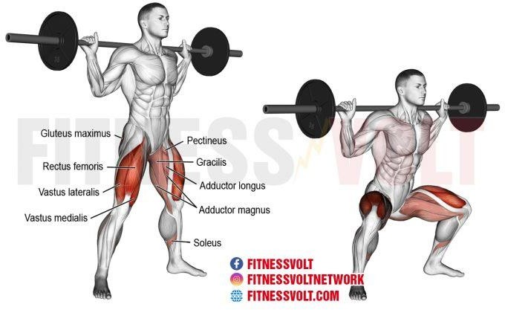
Importance of Kinesiology in physical Education
Designing and teaching of exercise/conditioning
/fundamental movements the knowledge of kinesiology is must.

Slide 28
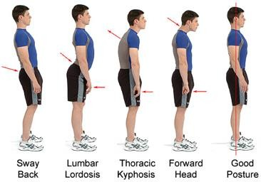
Importance of Kinesiology in physical Education
For physiotherapy, physical medicine purposes.
For postural analysis, and corrective physical education.

Slide 29
Anatomical Position

Slide 30
Fundamental Starting Position

Slide 31
Joint Movements
Also known as Anatomical Movements.
3 kinds of Joint Movements:
Angular Movements
Rotation Movements
Special Movements

Slide 32
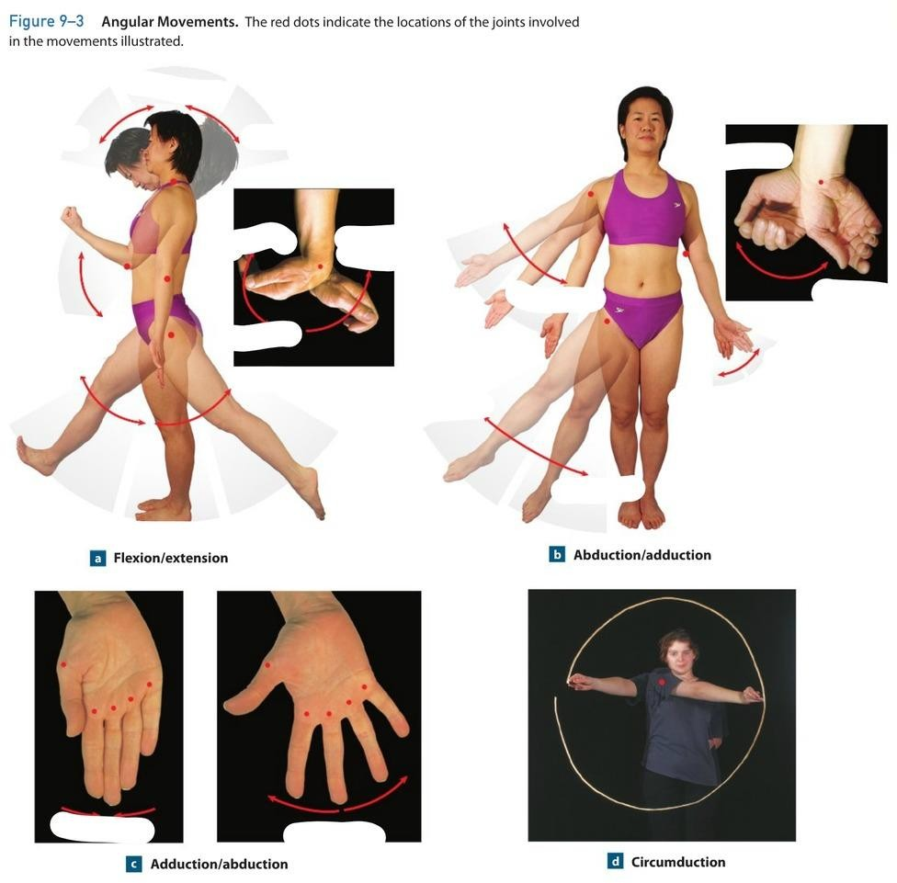
Angular movements
Increase or Decrease in the angle b/w articulating bones.
It’s types;
Flexion
Extension
Hyperextension
Abduction
Adduction
Circumduction
Lateral Flexion

Slide 33
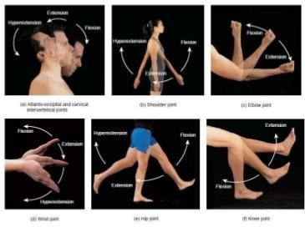
Flexion
Decreasing angle b/w articulation bones.
Takes body forward from anatomical position.
Allowed in:
Ball and socket Joint
Condyloid joint
Hinge joint
Pivot joint
Saddle joint

Slide 34
Extension
Increase angle b/w articulation bones.
Takes body backward from anatomical position.
Allowed in:
Ball and socket Joint
Condyloid joint
Hinge joint
Pivot joint
Saddle joint

Slide 35
Hyper Extension
Increase angle b/w articulation bones beyond the normal ROM.
Takes body further backward from anatomical position.
Allowed in:
Ball and socket Joint
Condyloid joint
Pivot joint
Saddle joint

Slide 36
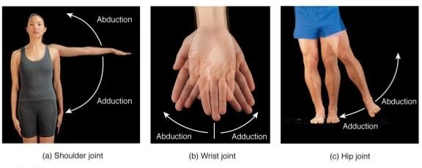
Abduction
Takes body part away from the midline of the body.
Joints permit these:
Ball and socket
Condyloid joint
Saddle joint

Slide 37
Adduction
Takes body part towards the midline of the body.
Joints permit these:
Ball and socket
Condyloid joint
Saddle joint

Slide 38
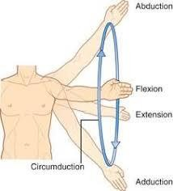
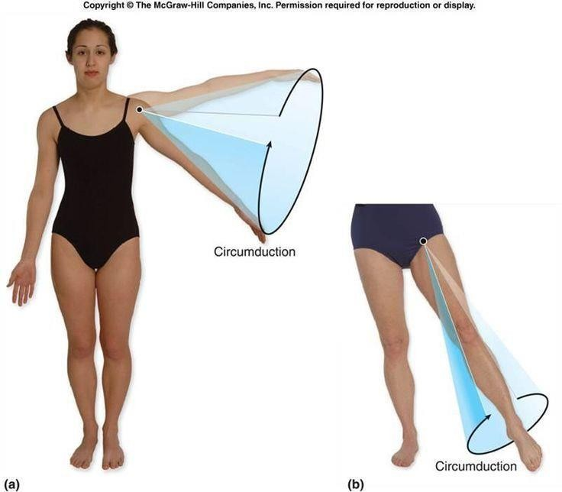
Circumduction
Combination of ;
Flexion, extension, abduction, adduction.
Conical Movement from joint.
Allowed at;
ball and socket jont
condyloid joint
saddle joint

Slide 39
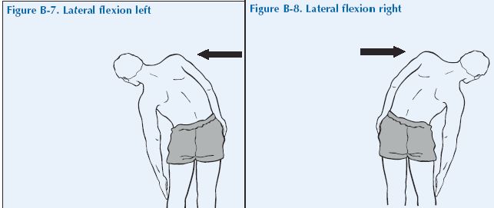
Lateral Flexion
Body part is taken away from median plane by bending.
Only possible at; Trunk and Neck joint.
“Side Bending”

Slide 40
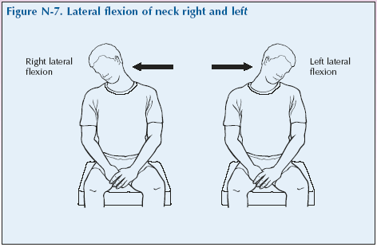

Slide 41
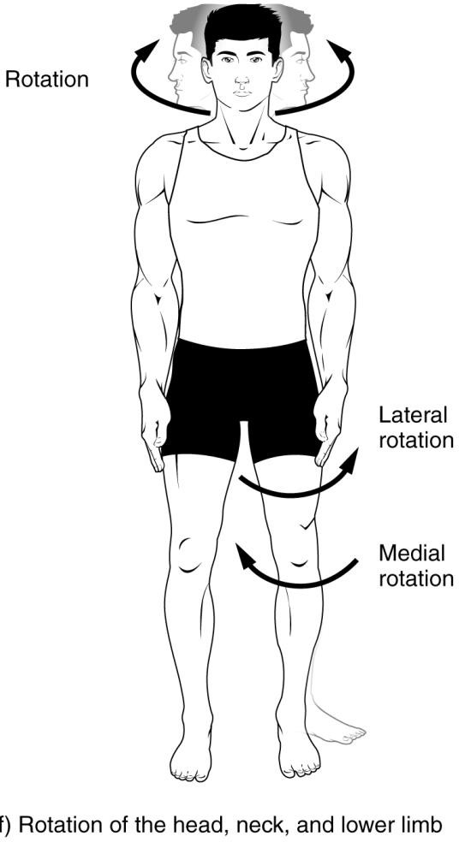
Rotation movement
Where something revolves around a single long axis.
Two kinds of rotation:
Medial/Internal Rotation
Lateral Rotation
Left/right rotation.

Slide 42
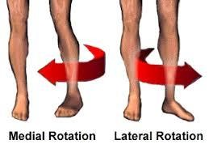
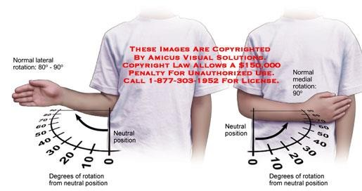
Medial Rotation
Internal rotation
Takes part of body inwards.
At shoulder and hip joint.

Slide 43
Lateral Rotation
External Rotation
Takes body part outwards.
At shoulder and hip joint.

Slide 44
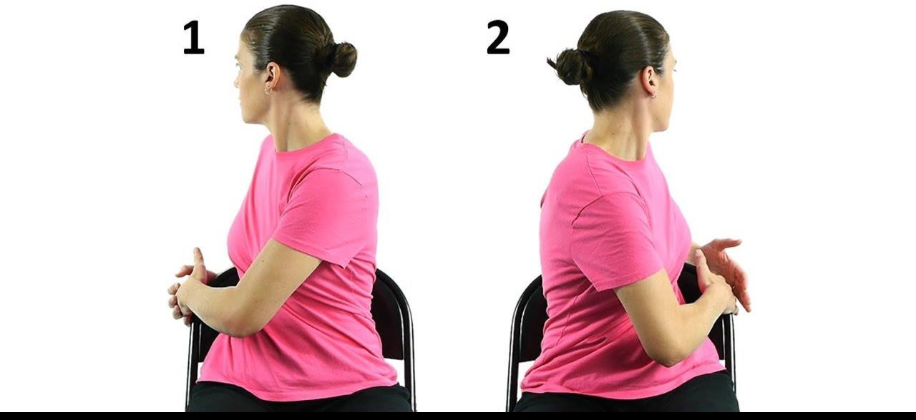
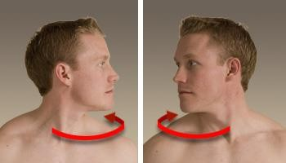
Left and Right rotation
At Trunk and Neck joint.
Reference point: Front of chest or neck.

Slide 45
Special Movment
Only occurs at certain joints.
Cannot be classified as angular and rotational.
Movements are as follows:
Elevation
Depression
Protraction
Retraction
Eversion
Inversion
Dorsiflexion
Plantarflexion
Pronation
Supination

Slide 46
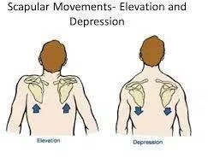
Special Movements
Elevation
Upward movement of structure.
ex. Shrugging your shoulder; elevation of scapula.
Depression
Downward movement of structure of the body. ex. Depression of shoulder joint.

Slide 47
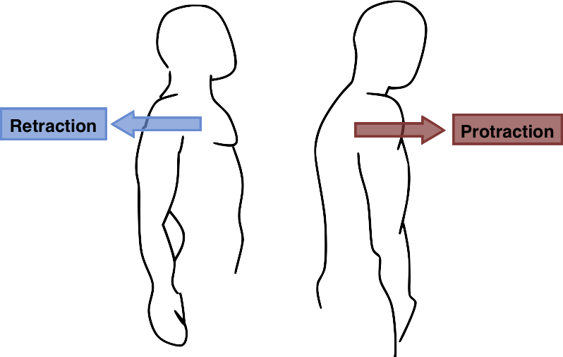
Special Movements
Protraction
Movement of structure in the anterior direction. ex. Crossing of arms; protraction of clavicle.
Retraction
Movement of structure in the posterior direction. ex. Uncrossing of arms; retraction of clavicle.

Slide 48
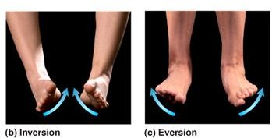
Special Movements
Eversion
Movement wherein plantar surface faces away from midline. ex. Foot eversion .
Inversion
Movement wherein plantar surface faces towards the midline.
ex. Foot inversion

Slide 49
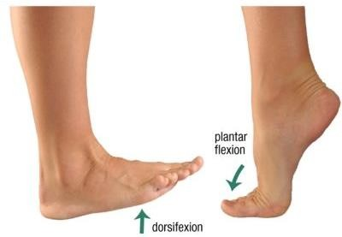
Special Movements
Dorsiflexion
Dorsum= upper surface; superior surface.
bending at the ankle where toe lifted toward the knee. ex. Ankle dorsiflexion.
Plantarflexion
bending at ankle when heel is lifted.
ex. Ankle plantarflexion.

Slide 50
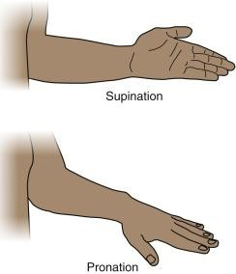
Special Movements
Pronation
a kind of rotational movement of radius and ulna where forearm wherein palm faces down.
ex. Pronation of forearm.
Supination
a kind of rotational movement of radius and ulna where forearm wherein palm faces up.
ex. Supination of forearm

Slide 51
