Slide 1
INTERTEMPORAL PRODUCTION DECISION
Presented by
Bhargab Das

Slide 2
Like a consumer, a producer also often has to decide as to how of the resources to be used in the current production and how much to be invested for future production.
To analysis the inter temporal production decision we adopt a simple two period framework (0 indicating current period and 1 indicating the future period). The resources an individual has at hand can be used to produced current goods or future goods.
For a given amount of productive resource of the firm, its options for present and future production can be presented by transformation or production possibility curve which slopes negatively and concave to the origin.

Slide 3
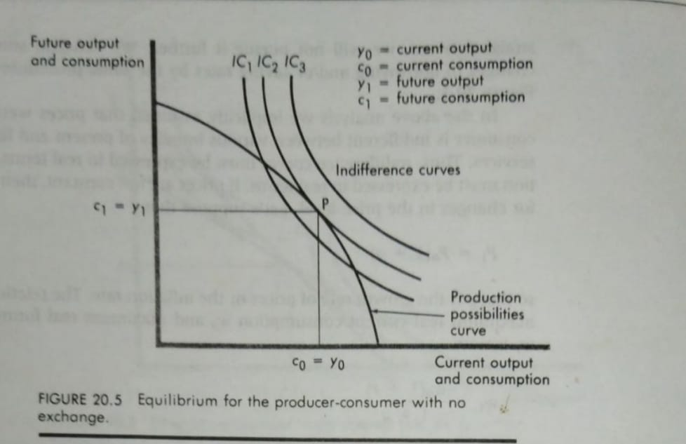
By superimposing the ICs on the production possibility curve, we can get the optimum for a producer-consumer who has no scope for exchange.

Slide 4
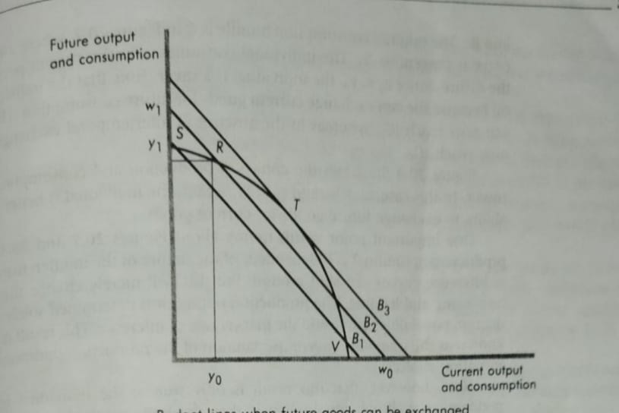
Let us assume an interest rate of r. An individual producing at point R in the below fig. Produces yo in the current period and y1 in the future period. Maximum current and future consumption is w0 and w1. Where w0 = y0+y1/(1+r) and w1 = y1+y0(1+r).

Slide 5
In the previous diagram the individual producing at point R can consume anywhere along the budget line B2. For an individual producing at point T, the budget line is B3. Similarly, for individual producing at point S or V, the budget line is B1.
The individual must now choose the production bundle and consumption bundle to maximize satisfaction. With a higher budget line, higher indifference curves can be reached. Thus, the individual will choose the production bundle corresponding to the highest possible budget line.

Slide 6
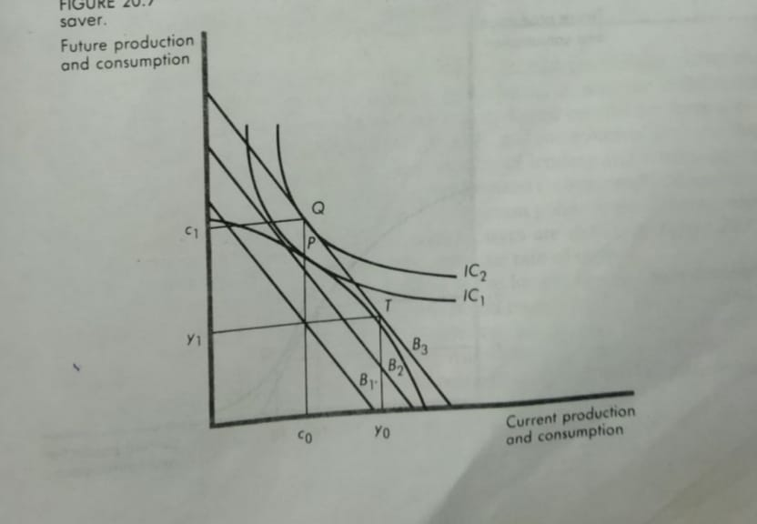
In the above fig. at point T the budget line is tangent to the PPC where current production is y0 and future production is y1.
Here optimum consumption bundle is Q where c0 is current consumption and c1 is future consumption.

Slide 7
Thank You

