Slide 1
Lewis Theory of Unlimited Supply of Labour
By,
Afshana Parveen
Assistant Professor Department ofEconomics
DR B.K.B. College

Slide 2
Main points of the Model
Introduction
The Model
Assumptions
Main features of the model- a) Dual Economy b) Capitalist Surplus
Diagrammatic Representation
End of growth Process
Criticisms
Conclusion

Slide 3
Introduction
Propounded by Prof. W.Arthur Lewis
Based on unlimited supply of labour
First published- Manchester School in May 1954
The Lewis Model
Supply of labour based model
Central Theme- since UDC are labour abundant and capital scare, so this abundant labour can be used as an engine of growth in such countries.

Slide 4
Assumptions
Supply of labour is unlimited or perfectly elastic
The economy is dualistic in nature- exists a modern capitalist sector and a rural subsistence sector
The output in the subsistence sector is less than that in the capitalist sector
Urban wages are higher than Rural subsistence wages
Production in the capitalist sector are driven by profit motive and the capitalists reinvest all their profits.

Slide 5
Features of the Lewis Model
Dual Economy-
Capitalist Sector- The capitalist sector is that sector of the economy which uses reproducible capital and pays capitalists for the use thereof.
Subsistence Sector- subsistence sector is that sector of the economy which is basically agriculture based.
the main problem- to provide employment to the unlimited supply of labour
Can be done- establishing industries or expanding industries at existing wage rate.
Mobilization of labour from subsistence to capitalists sector
Drawback- expansion of capitalists sector requires only skilled manpower
Quasi Drawback

Slide 6
Features of the Lewis Model
Capitalist’s Surplus-
Main aim is to maximise profit
Capitalists surplus is the difference between the Marginal productivity of labour and capitalist wage.
Labours are drawn from the subsistence sector on account of higher wages
Where is the profit/surplus?
High contribution to total output » capitalists surplus» reinvested» capital formation» new jobs more labours from the subsistence sector » capitalist surplus » reinvested » continues till the surplus labour is exhausted.
In this way the system is brought out of underdeveloped.

Slide 7
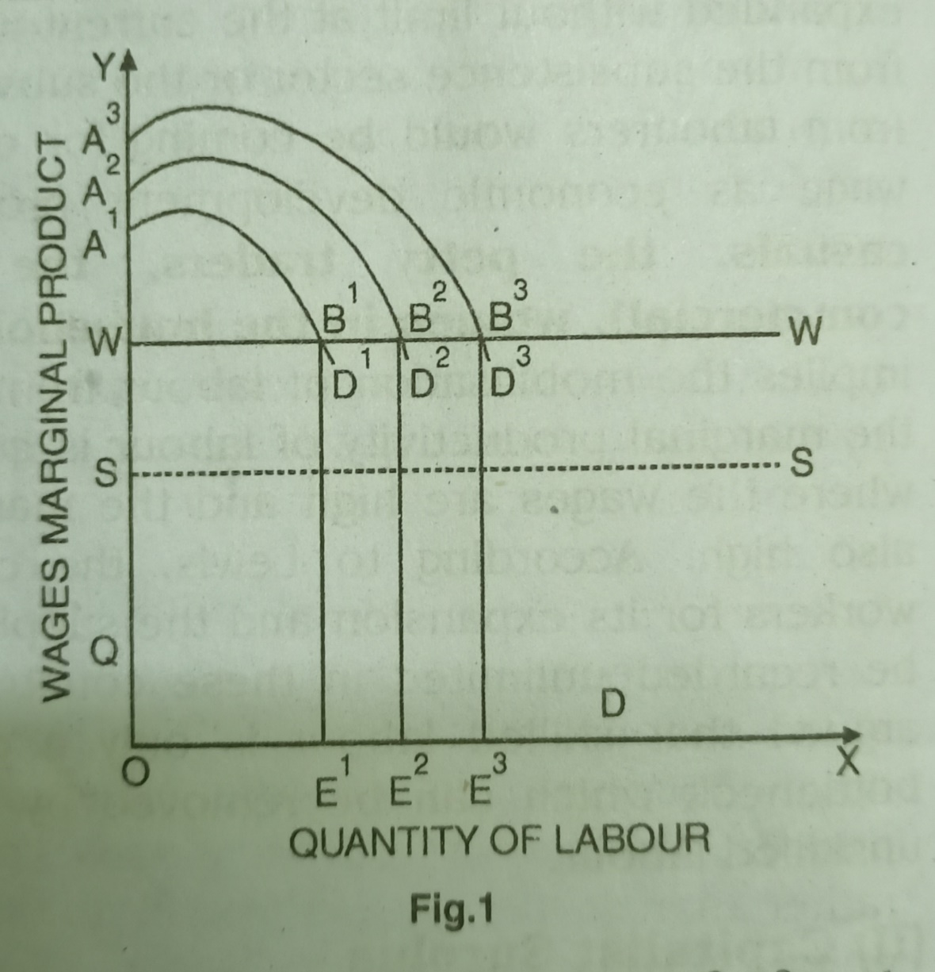
Diagrammatic Representation
OS- subsistence wage
OW- capitalist’s wage
WW is the perfectly elastic supply curve of labour
OE¹ ---- A¹D¹ ----- OA¹B¹E¹
OWB¹E¹-----wages paid to labours
WA¹B¹------surplus output
Reinvested– shift in MPL curve
Higher employment> higher surplus
Continue till surplus labours are exhausted
Supply curve be slope upwards from left to right> employment and wages will increase.

Slide 8
End of Growth Process
Expansion of capitalists sector will turn the terms of trade against them. They will be required to pay higher wages keeping their real income intact, thereby surplus vanishes
Expansion of the capitalists sector will reduce the population in the subsistence sector increasing the productivity of labour in the subsistence sector thereby increasing wages and reducing surplus
The labourers follows the capitalists way of life and agitates for higher wages thereby reducing surplus
The subsistence sector might develop new technologies over time thereby reducing the capitalists surplus.

Slide 9
Criticisms
Unrealistic Assumptions
One sided Theory
Migration of only unskilled labour
Emphasises on investment multiplier
The theory fails if new investment results in labour saving technology
Migration not easy
The theory still heads its head high as one of the important theories of development specially in the under developed nations where labour is abundant and capital is scarce

Slide 10
THANK YOU

