Slide 1
National Income & Related Aggregates
By
Afshana Parveen
Assistant Professor
Department of Economics
Dr. B.K.B. College, Puranigudam

Slide 2
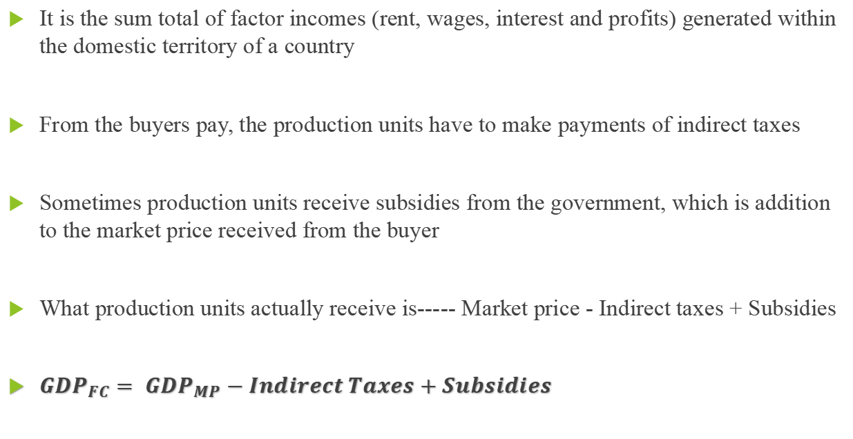
Gross Domestic Product at Factor Cost (${GDP}_{FC})$
It is the sum total of factor incomes (rent, wages, interest and profits) generated within the domestic territory of a country
From the buyers pay, the production units have to make payments of indirect taxes
Sometimes production units receive subsidies from the government, which is addition to the market price received from the buyer
What production units actually receive is----- Market price - Indirect taxes + Subsidies
${GDP}_{FC}= {GDP}_{MP}−Indirect Taxes+Subsidies$

Slide 3
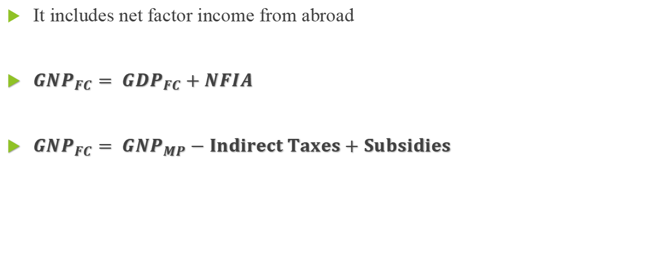
Gross National Product at Factor Cost (${GNP}_{FC})$
It includes net factor income from abroad
${GNP}_{FC}= {GDP}_{FC}+NFIA$
${GNP}_{FC}= {GNP}_{MP}−Indirect Taxes+Subsidies$

Slide 4
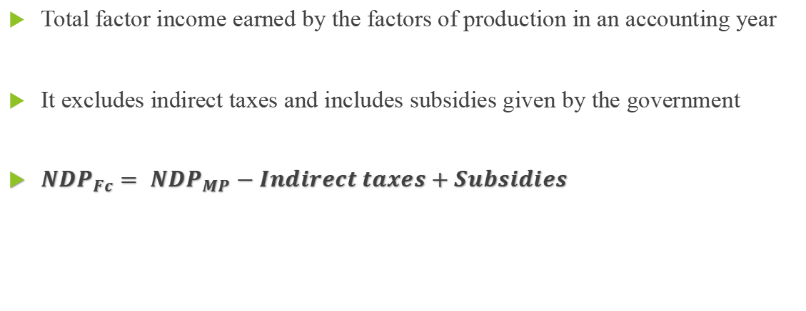
Net Domestic Product at Factor Cost (${NDP}_{FC})$
Total factor income earned by the factors of production in an accounting year
It excludes indirect taxes and includes subsidies given by the government
${NDP}_{Fc}= {NDP}_{MP}−Indirect taxes+Subsidies$

Slide 5
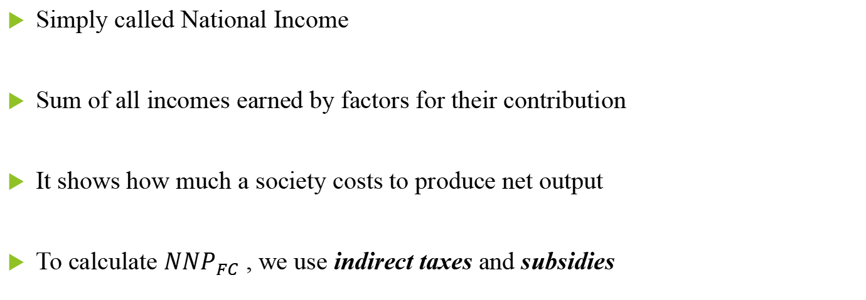
National Income OR National Income at Factor Cost (${NNP}_{FC}$)
Simply called National Income
Sum of all incomes earned by factors for their contribution
It shows how much a society costs to produce net output
To calculate ${NNP}_{FC}$ , we use indirect taxes and subsidies

Slide 6
Final value of goods and services (market prices) must be equal to
the cost involved in production (factor cost)
Market prices include indirect taxes, does not take into account the
subsidies given by govt.
To make equality, indirect taxes are subtracted and subsidies are added
${NNP}_{FC}$= ${NNP}_{MP}$ - Net Indirect Taxes
OR
${NNP}_{MP}$ - (Indirect taxes – Subsidies)
OR
${NNP}_{MP}$ - Indirect taxes + Subsidies

Slide 7
Thank You

