Slide 1
National Income & Related Aggregates
By
Afshana Parveen
Assistant Professor
Department of Economics
Dr. B.K.B. College, Puranigudam

Slide 2
Gross Domestic Product at Market Prices (${GDP}_{MP})$
Gross Domestic Product is the money value of all final goods and services produced by all the enterprises in the domestic territory of a country in a year.
Both resident and non-resident producers

Slide 3
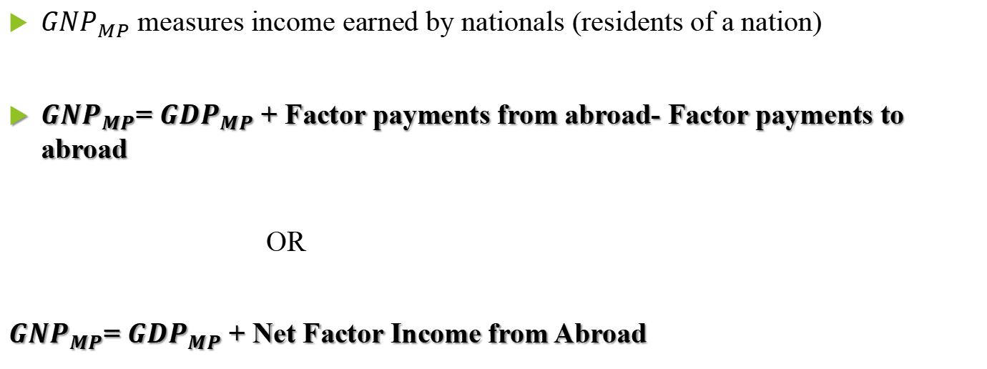
Gross National Product at Market Price (${GNP}_{MP}$)
${GNP}_{MP}$ measures income earned by nationals (residents of a nation)
${GNP}_{MP}$= ${GDP}_{MP}$ + Factor payments from abroad- Factor payments to abroad
OR
${GNP}_{MP}$= ${GDP}_{MP}$ + Net Factor Income from Abroad

Slide 4
Net Domestic Product at Market Price (${NDP}_{MP})$
The value of GDP includes the cost of wear and tear of fixed capital (depreciation)
GDP does not tell us the net flow of goods and services in the economy.
Therefore, the term net product has been included
Net domestic product is obtained by deducting depreciation from the gross domestic product
${NDP}_{MP}= {GDP}_{MP}−Depreciation$

Slide 5
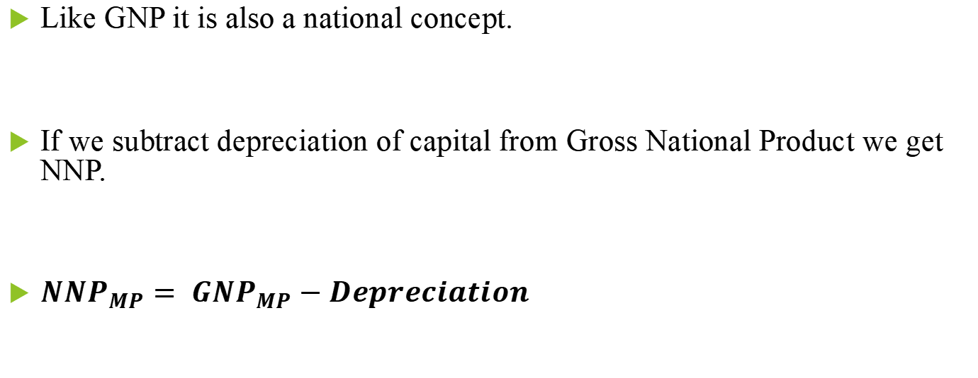
Net National Product at Market Price (${NNP}_{MP}$)
Like GNP it is also a national concept.
If we subtract depreciation of capital from Gross National Product we get NNP.
${NNP}_{MP}= {GNP}_{MP}−Depreciation$

Slide 6
Thank You

