Slide 1
INDIA’S ELECTORAL SYSTEM
Paper name: Constitutional Government and Democracy in India
Paper Code: POL-HC-1026
Presented by
DR. PRANAMI LASKAR
DEPARTMENT OF POLITICAL SCIENCE,
DR. BKB COLLEGE, PURANIGUDAM

Slide 2
Election is an essential feature of parliamentary democracy.
In our democracy election plays a significant role in selecting the representatives of the Government through a proper procedure.
Election is a means for the masses to choose their representatives freely.

Slide 3
ABC of Indian Election:
Election is the formal process of selecting a person for public office by voting.
Article 324 to 329 in Part XV of the Indian Constitution make the provision for the electoral system of the country.
In India all the adult citizens irrespective of their caste, class, creed, sex and religion can take part in the electoral process.
Our constitution provides for a direct election of the representatives of the people.
Members of the Lok Sabha, the State Legislative Assemblies, Municipalities and Village Panchayants are directly elected by the people.

Slide 4
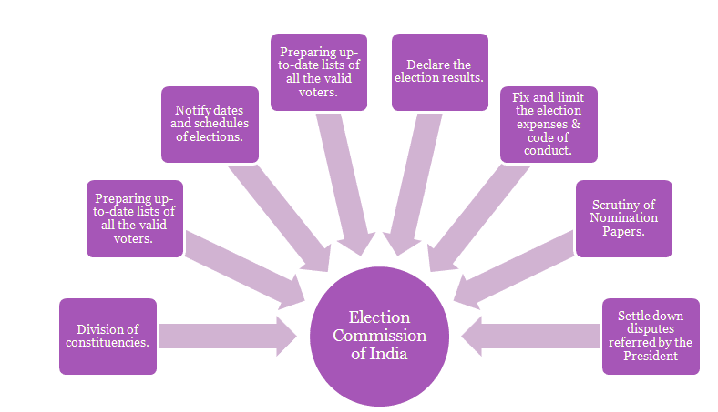
Election Machinery:
Under Article 324 of the Constitution of India, the Election Commission of India is vested with the power of conducting the elections in India (i.e. elections of Lok Sabha and State Legislative Assembly election)
Election Commission of India (ECI)
Chief Electoral Officer (CEO)
District Election Officer (DEO)
Returning Officer (RO)
Electoral Registration Officer (ERO)
Presiding Officer
Observers

Slide 5
Election Process:
Schedule of Election
Delimitation of constituencies
Preparation of Electoral rolls
Notification of elections and appointment of Returning Officers and other staff
Filling of nomination papers
Scrutiny of nomination papers
Withdrawal of nominations
Election Campaigns
Polling of votes
Voting Procedure
Counting of Votes
Declaration of result

Slide 6
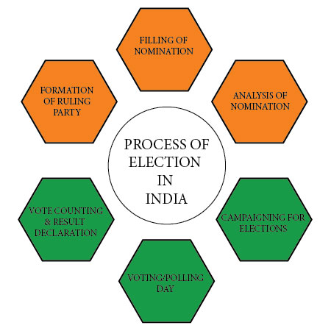

Slide 7
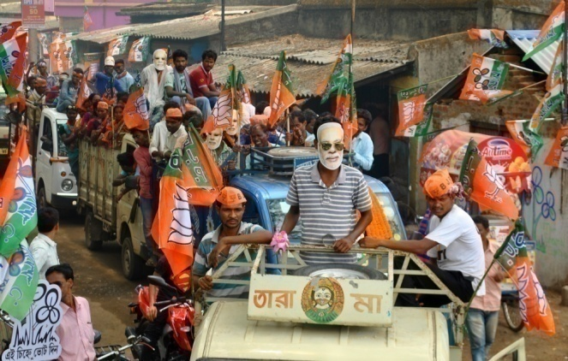
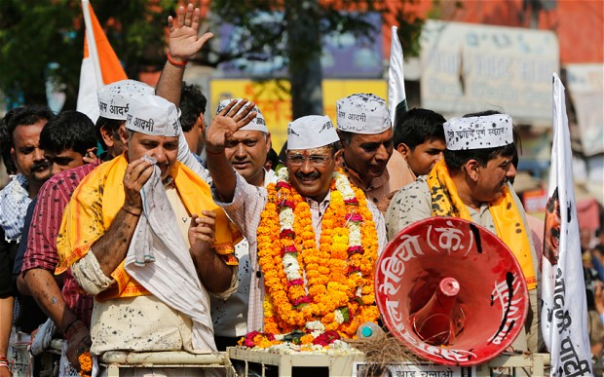
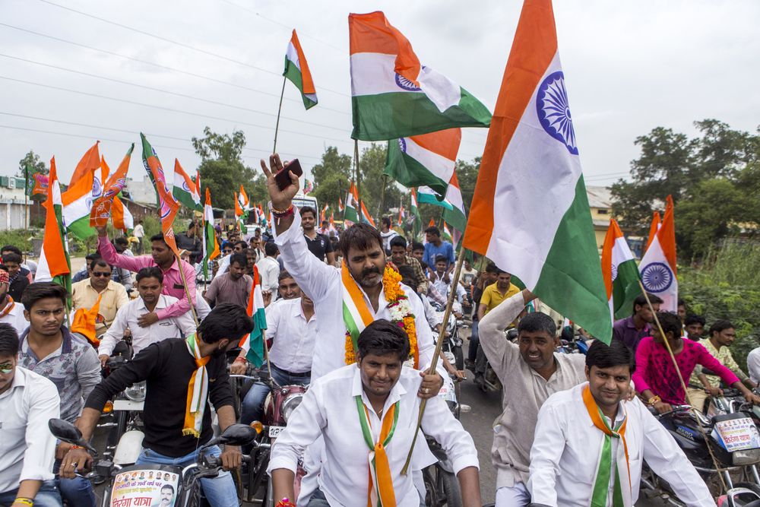
Election Campaign:

Slide 8
Voting:
Voting is done by secret ballot.
Polling Stations are set up usually in public institutions such as schools and community halls.
To enable as many electors as
possible to vote, the
officials of Election
Commission try to ensure
that there is a polling station
within 2kms of every voter.
On entering the polling station, the elector is checked against the electoral roll and allowed to vote in the EVM.
The Election Commission of India took a historic decision to use only EVMs in the Lok Sabha election of 2004.

Slide 9
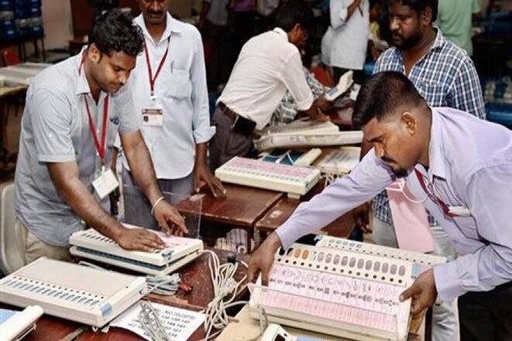
Supervising Elections: The Election Commission appoints a large number of observers to ensure that the election is conducted fairly.
Counting of Votes: After the polling has finished, the votes are counted under the supervision of Returning Officers and Observers appointed by the Election Commission.

Slide 10
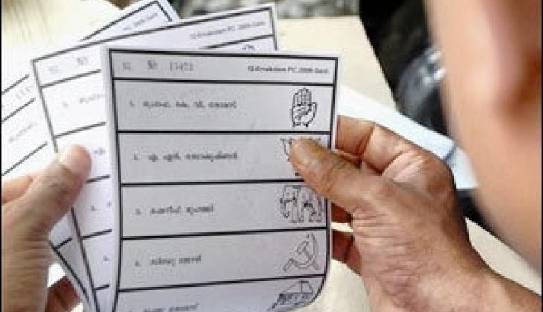
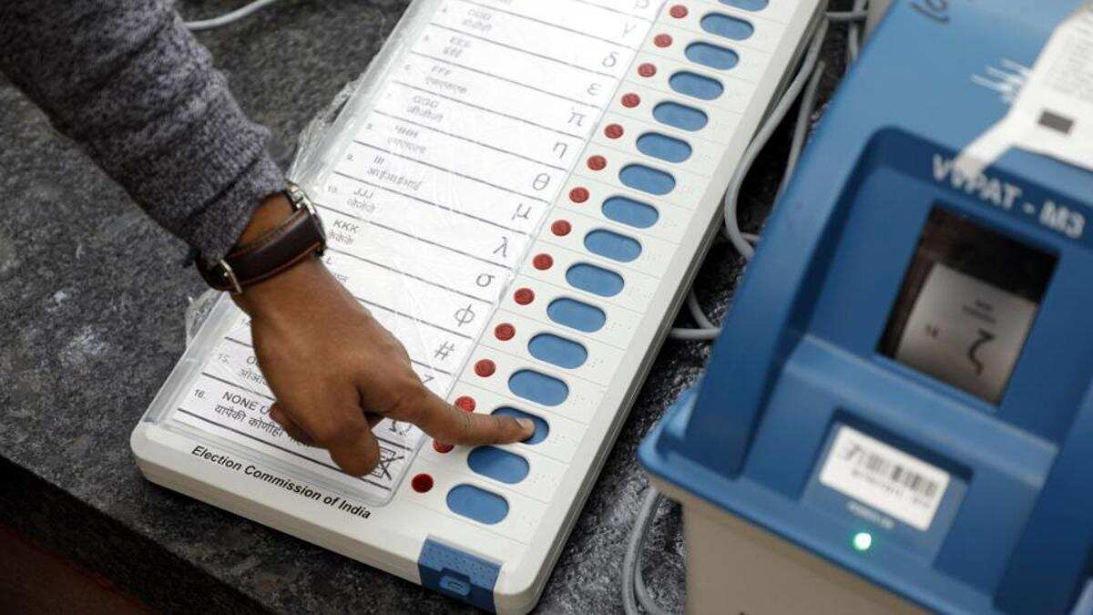
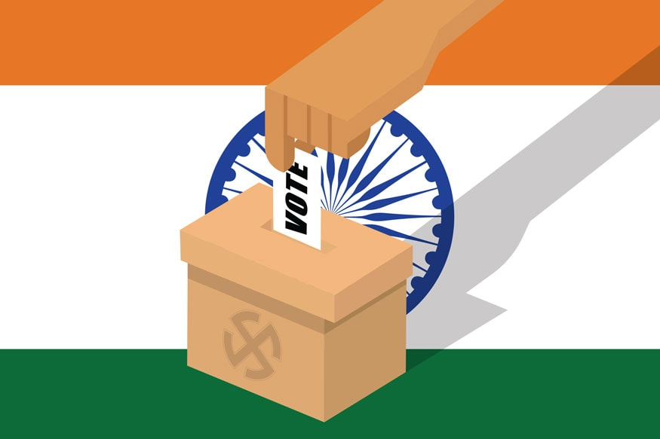
Voting Machineries:
A Ballot paper is a form which voters fill out in order to exercise their right to vote in election.
Electronic Voting Machine is a simple electronic device used to record votes.
It replaced ballot papers and boxes which were used earlier in conventional voting system.
EVMs make the process of counting of votes faster.

Slide 11
Role of Media:
Media has a great role in covering the whole electoral process. Media i.e. electronic media, print media and social media play tremendous role in molding public opinion. For example we can see in last few elections how media influences the voters.

Slide 12
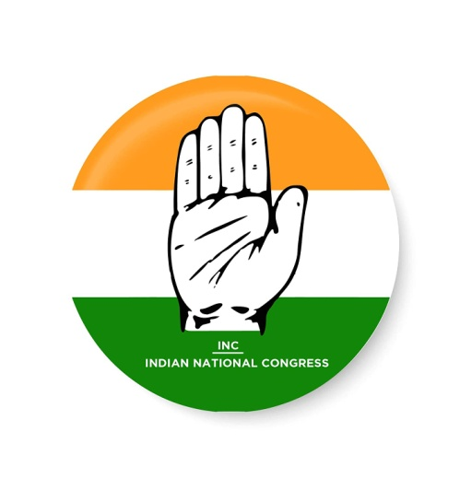
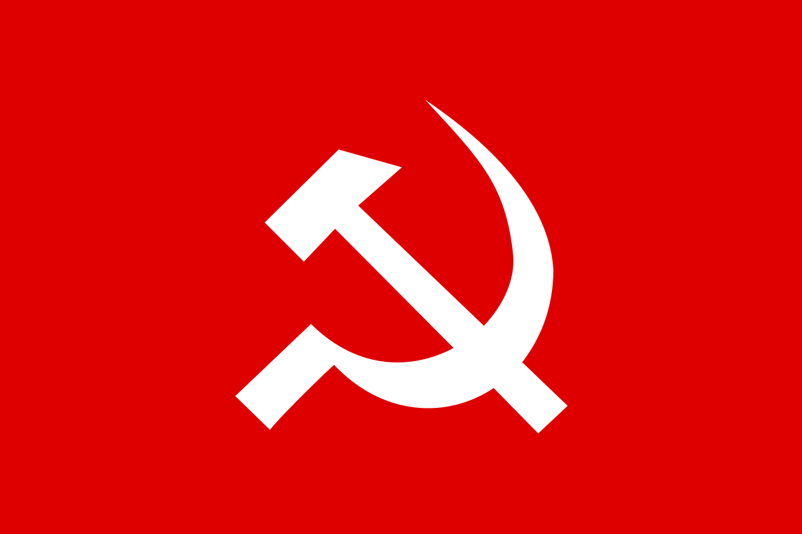
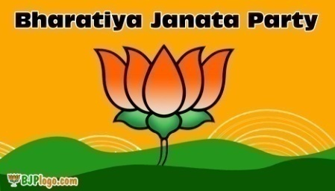
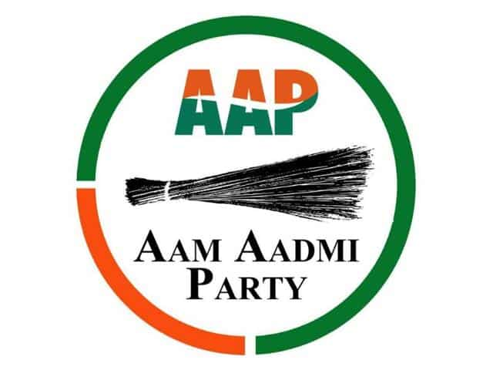
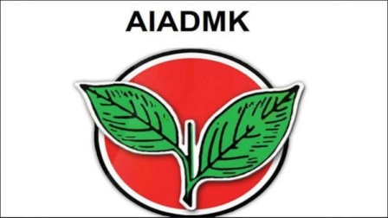
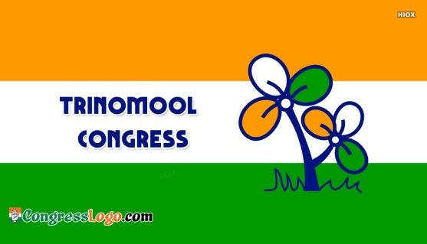
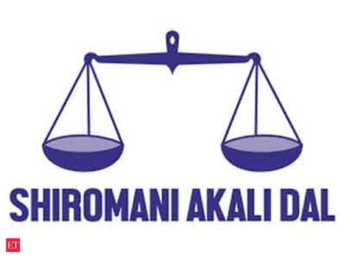
Symbols:

Slide 13
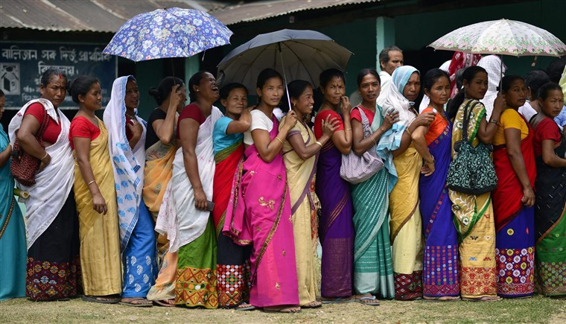
POLLING DAY

Slide 14
Articles related to Elections at a glance:
Article 324: Superintendence, Direction and control of elections to be vested in an Election Commission.
Article 325: No person to be ineligible for inclusion in, or to claim to be included in a special, electoral roll on grounds of religion, race, caste or sex.
Article 326: Elections to the House of the People and to the Legislative Assemblies of states to be on the basis of adult suffrage.
Article 327: Power of parliament to make provision with respect to elections to Legislatures.
Article 328: Power of Legislature of a state to make provision with respect to elections to such Legislature.
Article 329: Bar to interference by courts in electoral matters.
Article 329 (A): Special provision as to elections to Parliament in the case of Prime Minister and Speaker (Repealed).

Slide 15
Electoral Reforms:
The various Committees and Commissions which have examined our electoral system, election machinery as well as election process; suggested various reforms in the course of time.
For example: 1. Tarkunde Committee
2. Dinesh Goswami Committee
3. Vohra Committee
4. Indrajit Gupta Committee etc.

Slide 17
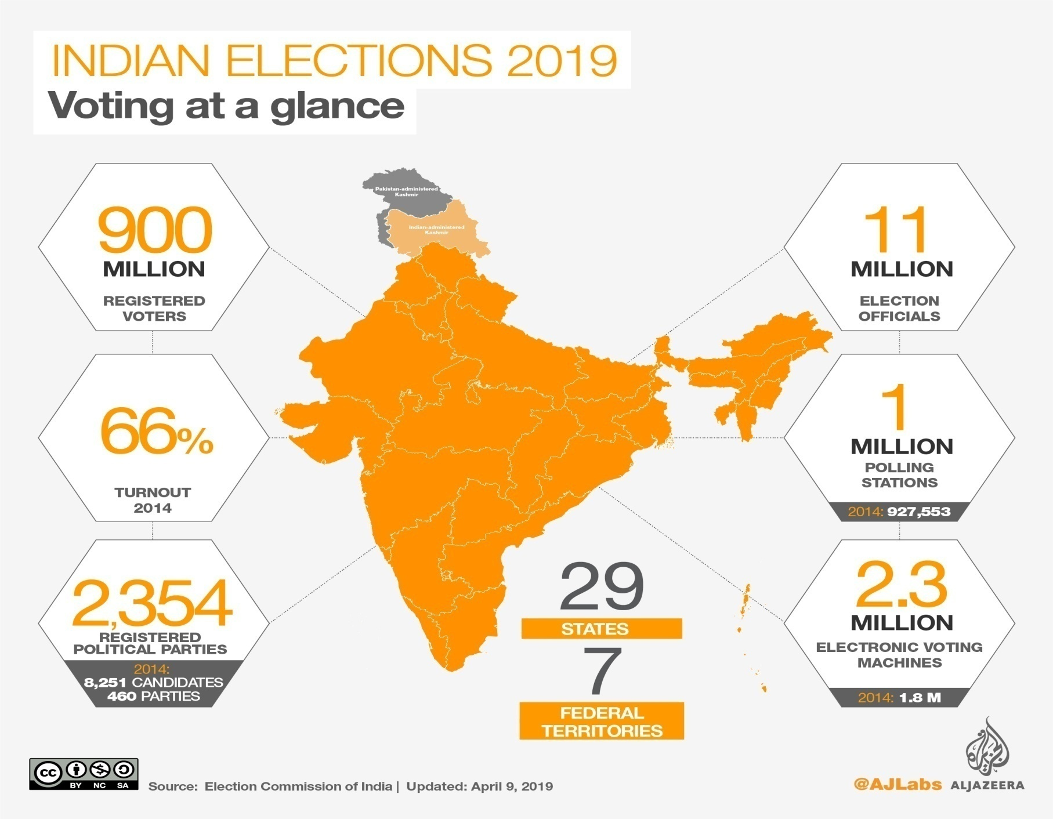

Slide 18
Conclusion:
Without a well organized and effectively working election system, no democratic system can really become operative.

Slide 19
Thank You

